Slide 1
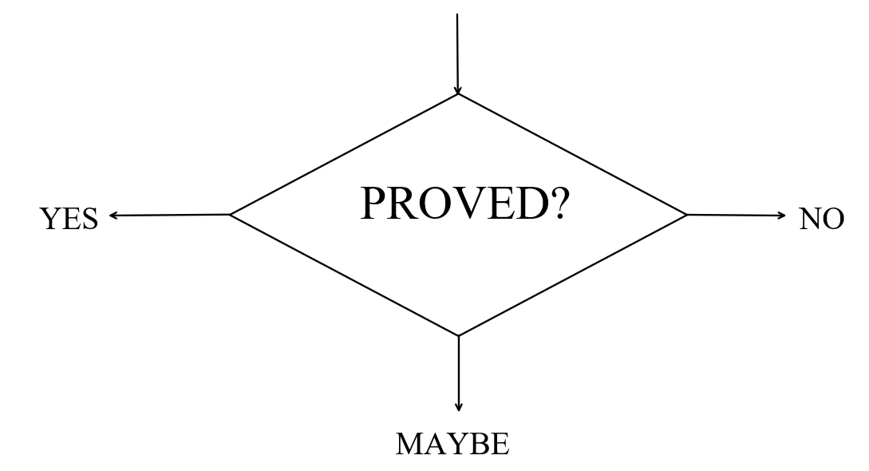
Formal verification project
By Robert Litvak
& George Vayner

Slide 2
plan
Brief code overview
Verification modes
Verification output
How to use
Benchmarks
Demo

Slide 3
brief code overview
utils.py
cfg_nodes.py
cfg.py
path.py
path_finder.py
verifier.py
main.py
run_all_tests.py

Slide 4
utils.py
A module with general auxiliary functions for:
Printing and verbosity
Parsing verifier configuration
Work with AST
Transformation of AST subtrees to Z3 expressions
Proving formulas using Z3 and Spacer
Generating a readable output
Drawing CFG

Slide 5
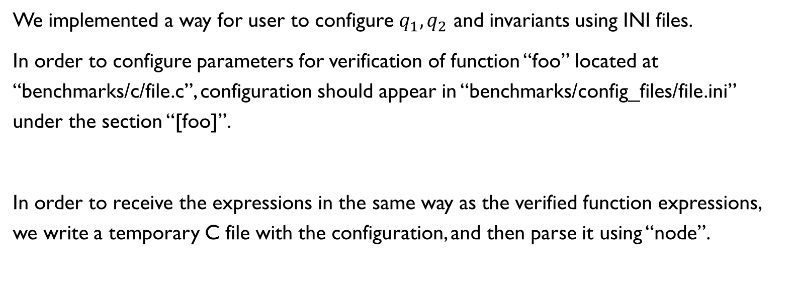
utils.py – reading user configuration
We implemented a way for user to configure $q_{1},q_{2}$ and invariants using INI files.
In order to configure parameters for verification of function “foo” located at “benchmarks/c/file.c”, configuration should appear in “benchmarks/config_files/file.ini” under the section “[foo]”.
In order to receive the expressions in the same way as the verified function expressions, we write a temporary C file with the configuration, and then parse it using “node”.

Slide 6
utils.py – AST to z3
We have a set of functions that help us to convert an AST subtree representing an expression to the same expression in Z3
All these functions are named “convert_<something>_to_z3”
But it’s enough to use the “convert_expression_to_z3” function, which uses all the rest
This method can handle constants (also true and false), variables, arrays, some keywords (implies, forall, exists), expressions inside “( )”, unary and binary operators

Slide 7
utils.py – CFG visualization
When the CFG is ready, and all its paths were calculated, the function “draw_cfg” can be used in order to create the visualized CFG
We are using the “graphviz” module for this purpose
Edges of each path appear in different colors (up to 10 colors for now)
Some edges can be duplicated if appear in more than one path

Slide 8
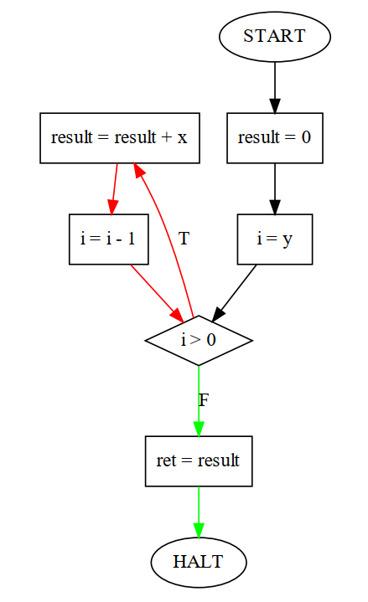
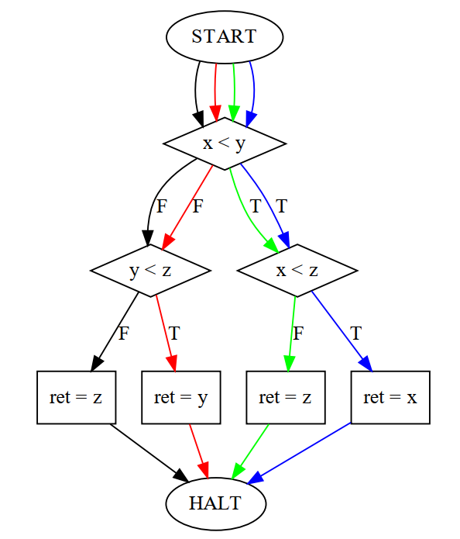
utils.py – CFG visualization EXAMPLEs

Slide 9
cfg_nodes.py
A module that defines a class for each possible type of CFG nodes:
Start
Halt
Assignment
Condition
Assert

Slide 10
CFG.py
A module responsible for building a program CFG
The CFG is built in bottom-up style – from the end of the program to the beginning
CFG is discovered scope after scope, recursively, from the end to the beginning
For each statement type there is a method in class CFG that builds the part of the CFG which is related to the statement

Slide 11
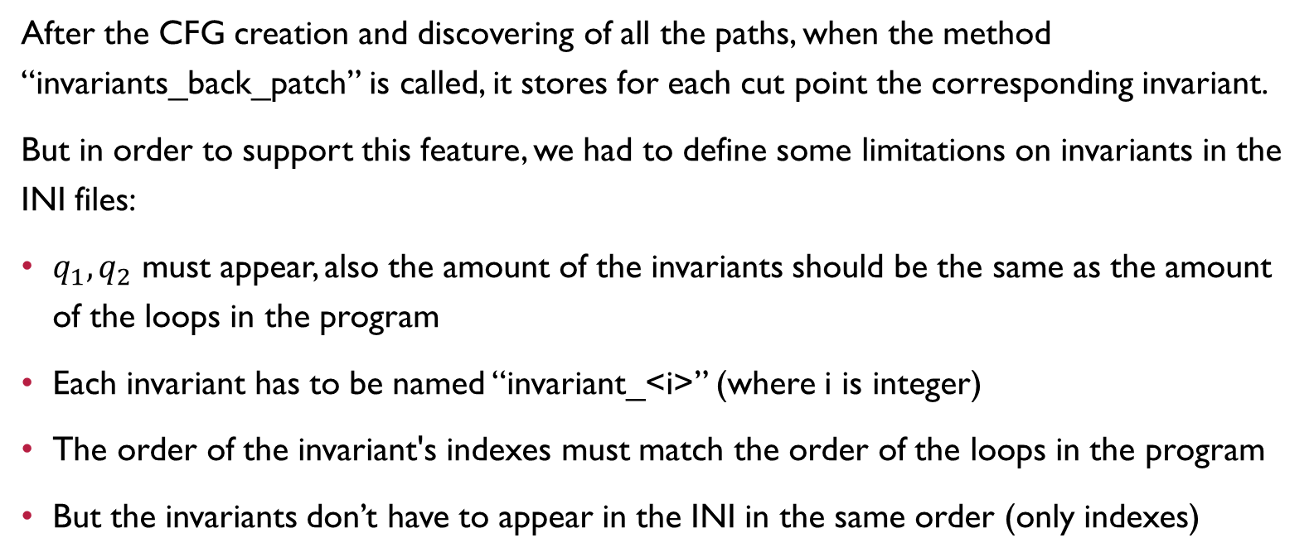
CFG.py – invariants backpathcing
After the CFG creation and discovering of all the paths, when the method “invariants_back_patch” is called, it stores for each cut point the corresponding invariant.
But in order to support this feature, we had to define some limitations on invariants in the INI files:
$q_{1},q_{2}$ must appear, also the amount of the invariants should be the same as the amount of the loops in the program
Each invariant has to be named “invariant_<i>” (where i is integer)
The order of the invariant's indexes must match the order of the loops in the program
But the invariants don’t have to appear in the INI in the same order (only indexes)

Slide 12

INI configuration – examples

Slide 13
path.py
Represents a single path in the CFG.
Contains methods for:
Calculating state transformation (T), reachability condition (R), array constraints (AC)
Calculating a Z3 representation of the path invariants
Path printing
Path verification (will be described later in verification modes section)

Slide 14
path_finder.py
Responsible for finding all the paths in the given CFG.
This is done in 2 steps:
From each already discovered cut point, find all the neighbor cut points (BFS-style)
Find the paths between each neighbor cut points (using DFS)

Slide 15
Verifier.py
Implements the verifier and all the verification modes
Uses class CFG to build the CFG of a program (if required, also to draw it)
Uses class PathFinder to discover all the CFG paths
According to the mode, performs a required verifier

Slide 16

Verification modes

Slide 17
Verification modes
Paths Verification (P)
Manual Horn Clauses (MHC)
Fixed Point (FP)

Slide 18
Verification modes
By default, the verifier runs in FP mode
If cannot produce a result in FP mode (for example, due to some error), the verifier will rerun itself in MHC mode
If Z3 returns unsat or unknown in MHC mode, the verifier will rerun itself in P mode

Slide 19
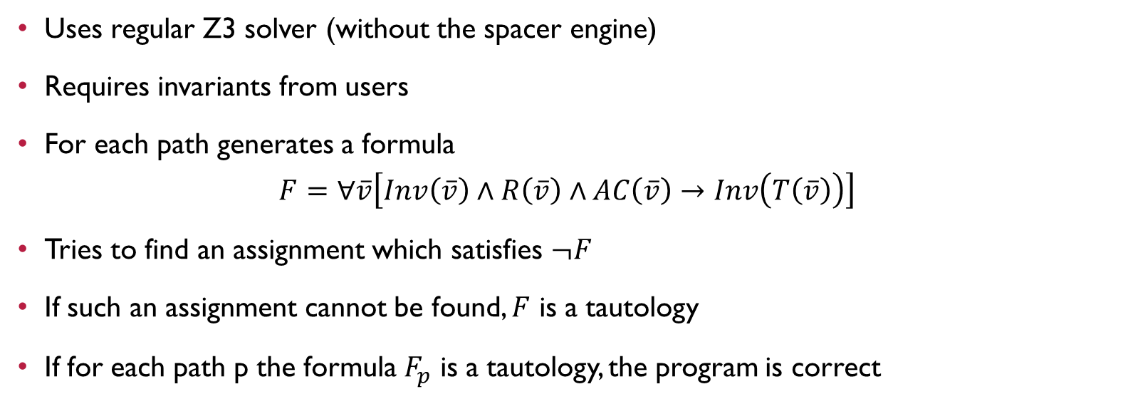
paths verification (p)
Uses regular Z3 solver (without the spacer engine)
Requires invariants from users
For each path generates a formula $F=∀\overline{v}\left[Inv\left(\overline{v}\right)∧R\left(\overline{v}\right)∧AC\left(\overline{v}\right)→Inv\left(T\left(\overline{v}\right)\right)\right]$
Tries to find an assignment which satisfies $¬F$
If such an assignment cannot be found, $F$ is a tautology
If for each path p the formula $F_{p}$ is a tautology, the program is correct

Slide 20
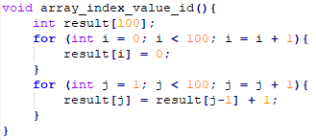
paths verification - example

Slide 21
paths verification - example

Slide 22
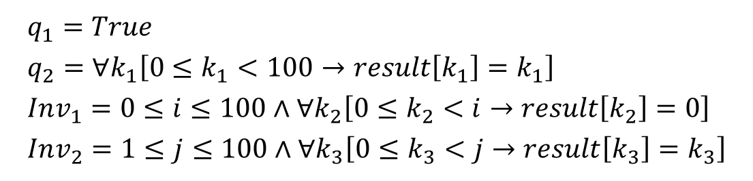
paths verification - example
$$q_{1}=True \\ q_{2}=∀k_{1}\left[0≤k_{1}<100→result\left[k_{1}\right]=k_{1}\right] \\ Inv_{1}=0≤i≤100∧∀k_{2}\left[0≤k_{2}<i→result\left[k_{2}\right]=0\right] \\ Inv_{2}=1≤j≤100∧∀k_{3}\left[0≤k_{3}<j→result\left[k_{3}\right]=k_{3}\right]$$

Slide 23
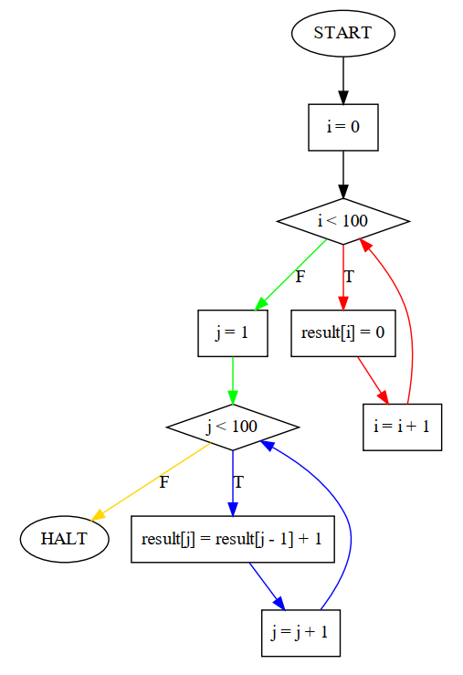
paths verification - example

Slide 24
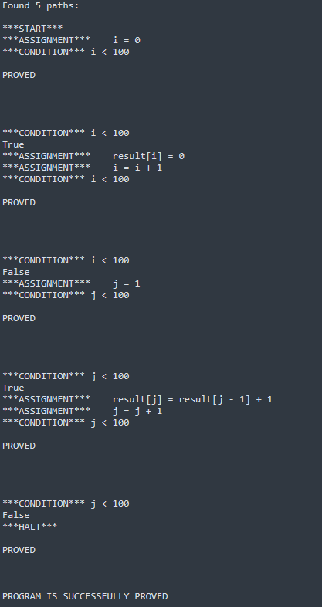
paths verification - example

Slide 25
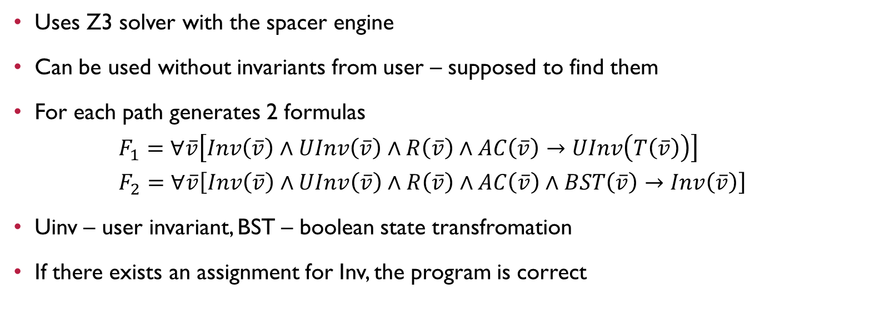
Manual Horn clauses (MHC)
Uses Z3 solver with the spacer engine
Can be used without invariants from user – supposed to find them
For each path generates 2 formulas $F_{1}=∀\overline{v}\left[Inv\left(\overline{v}\right)∧UInv\left(\overline{v}\right)∧R\left(\overline{v}\right)∧AC\left(\overline{v}\right)→UInv\left(T\left(\overline{v}\right)\right)\right]$ $F_{2}=∀\overline{v}\left[Inv\left(\overline{v}\right)∧UInv\left(\overline{v}\right)∧R\left(\overline{v}\right)∧AC\left(\overline{v}\right)∧BST\left(\overline{v}\right)→Inv\left(\overline{v}\right)\right]$
Uinv – user invariant, BST – boolean state transfromation
If there exists an assignment for Inv, the program is correct

Slide 26
MHC usage in our verifier
The main problem with MHC mode is that when it finds that there is no proper assignment for Inv, it returns nothing but “unsat”.
In this case, it’s hard to give users an information about why the program is not correct.
But there are problems for the Fixed-Point verifier with programs that has paths without loops.
So, we mainly use MHC mode for this type of programs.

Slide 27
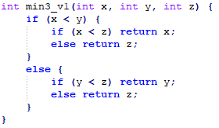
MHC verification - example

Slide 28
MHC verification - example

Slide 29
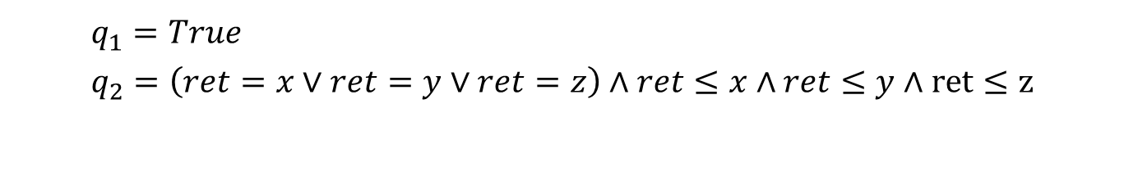
MHC verification - example
$$q_{1}=True \\ q_{2}=\left(ret=x∨ret=y∨ret=z\right)∧ret≤x∧ret≤y∧ret≤z$$

Slide 30
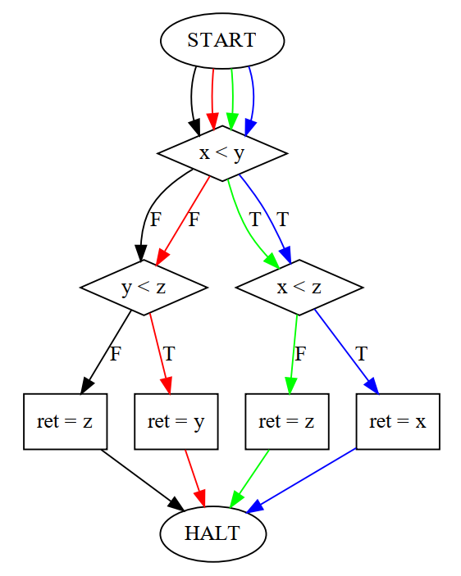
MHC verification - example

Slide 31
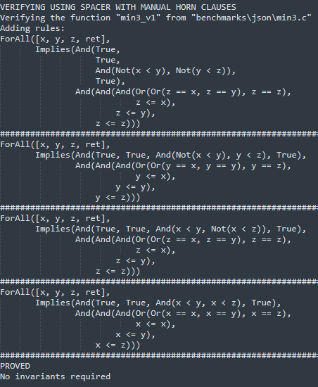
MHC verification - example

Slide 32
fixed point (FP)
Uses Z3 solver with the spacer engine (uses class z3.FixedPoint)
Can be used without invariants from user – supposed to find them
Generates a set of rules and queries – the logic is similar to what we’ve seen in MHC
But syntax is different
If there exists an assignment for Inv, the program is correct

Slide 33
fixed point problems
We’ve found that z3.FixedPoint object defines a lot of limitations:
Cannot use “/” or “%”
Has troubles with “exists” and “forall”
But the main problem is that if using z3.FixedPoint without rules, each query will return True.
This is problematic for programs without loops.
So, in any case of a problem, we use MHC mode instead.

Slide 34
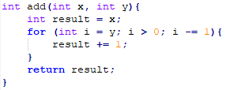
FP verification - example

Slide 35

FP verification - example

Slide 36
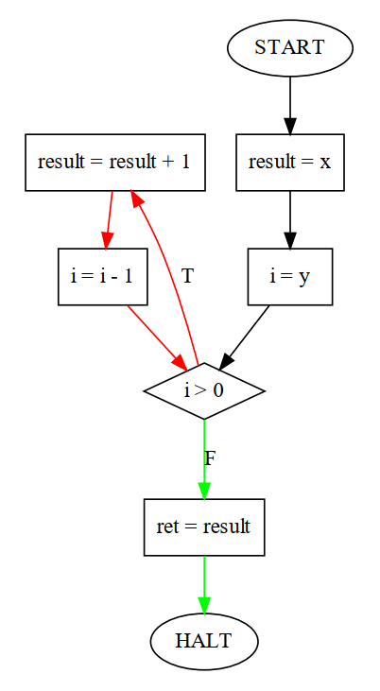
FP verification - example

Slide 37
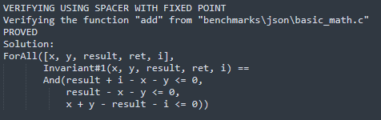
FP verification - example

Slide 38
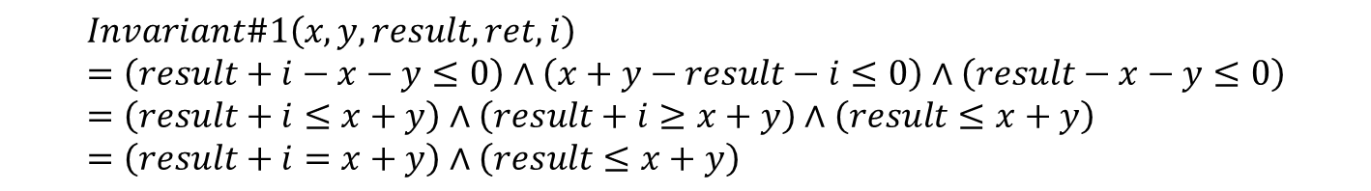
FP verification - example
$$Invariant\#1\left(x,y,result,ret,i\right)=\left(result+i−x−y≤0\right)∧\left(x+y−result−i≤0\right)∧\left(result−x−y≤0\right)=\left(result+i≤x+y\right)∧\left(result+i≥x+y\right)∧\left(result≤x+y\right)=\left(result+i=x+y\right)∧\left(result≤x+y\right)$$

Slide 39

verification output

Slide 40
verification output
Our verifier provides textual log of the verification process
It has 5 verbosity levels
If using “run_all_tests.py”, there will be a log file for each function with each verbosity level in “output” directory
Also, there is an option to get a CFG visualization (stored in “CFGs” directory)

Slide 41
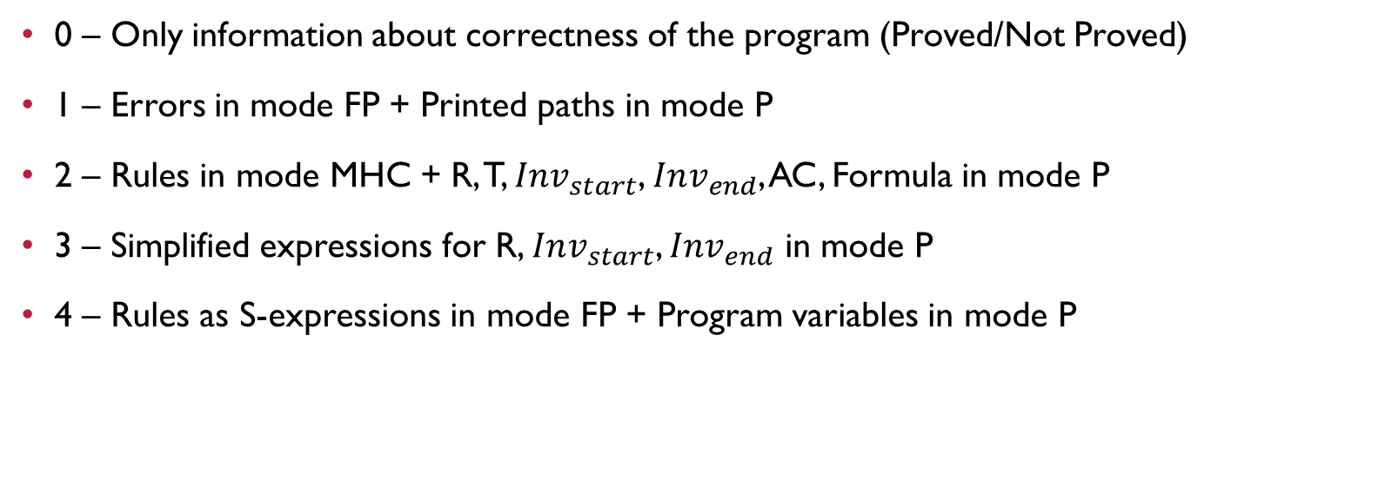
verbosity levels
0 – Only information about correctness of the program (Proved/Not Proved)
1 – Errors in mode FP + Printed paths in mode P
2 – Rules in mode MHC + R, T, $Inv_{start}$, $Inv_{end}$, AC, Formula in mode P
3 – Simplified expressions for R, $Inv_{start}$, $Inv_{end}$ in mode P
4 – Rules as S-expressions in mode FP + Program variables in mode P

Slide 42
output is ready
If it’ll help, we’ve already prepared and added to the GitHub project repository log files for all the available benchmarks, and with all the verbosity levels.
Also, we’ve added to the project repository the visualized CFGs for all the available benchmarks.
The slides are there as well ☺

Slide 43

how to use

Slide 44
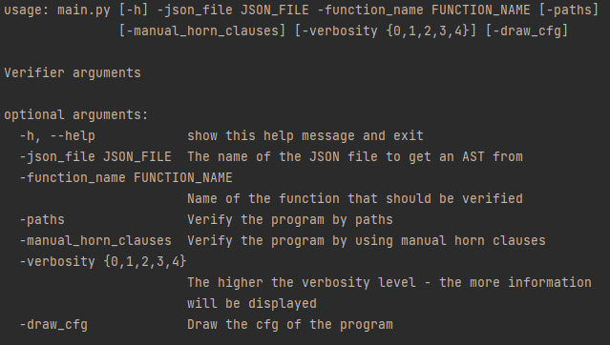
how to use

Slide 45

Benchmarks

Slide 46
benchmarks
We’ve got 34 benchmarks in 7 C files
28 benchmarks are correct and were proved (in different modes)
6 benchmarks are not correct (were designed like that), and their incorrectness was proved as well

Slide 47
min3.c
Given benchmark file
Contains 3 functions: min3_v1, min3_v2, min3_v3
All the functions contain no loops
All the functions were proved in MHC mode

Slide 48
array.c
Given benchmark file
Contains 3 functions: min3_array, min3_array_indirect, sort3
All the functions contain no loops
All the functions were proved in MHC mode

Slide 49
basic_math.c
Contains 6 functions: add, sub, mul, div, mod, abs
add and sub were proved in FP mode with no given invariants
mul was proved in FP mode with help – we provided a partial invariant
div, mod were proved in P mode with manually found invariants
abs contains no loops, and was proved in MHC mode

Slide 50
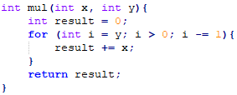
mul

Slide 51

mul

Slide 52
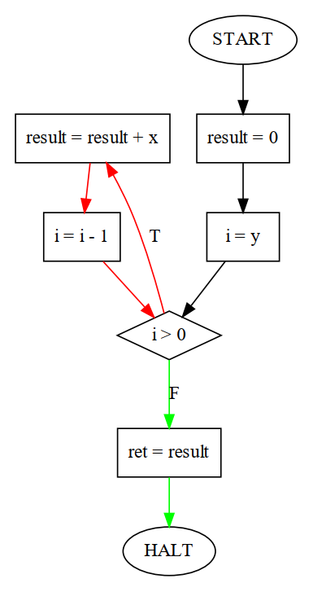
mul

Slide 53
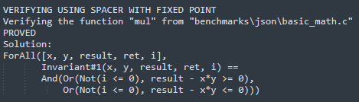
mul

Slide 54
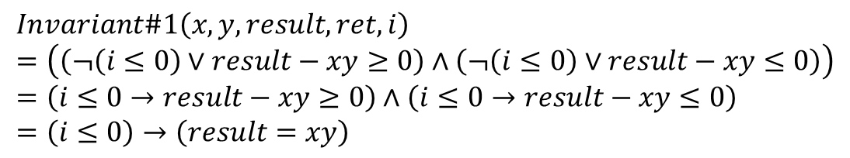
mul
$$Invariant\#1\left(x,y,result,ret,i\right)=\left(\left(¬\left(i≤0\right)∨result−xy≥0\right)∧\left(¬\left(i≤0\right)∨result−xy≤0\right)\right)=\left(i≤0→result−xy≥0\right)∧\left(i≤0→result−xy≤0\right)=\left(i≤0\right)→\left(result=xy\right)$$

Slide 55
advanced_math.c
Contains 8 functions: gcd, is_prime, fibonacci_array, factorials_array, five_factorials, limited_factorial_with_while, limited_factorial_with_for, power_of_two
gcd and is_prime were proved only for small inputs (<6 for gcd, <=17 for is_prime)
fibonacci_array, factorials_array were proved in P mode with manually found invariants
five_factorials contains no loops, and was proved in MHC mode
limited_factorial_with_while, limited_factorial_with_for, power_of_two were proved for a limited inputs, but in FP mode (that was surprising)

Slide 56
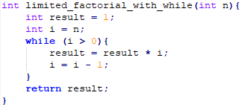
limited_factorial_with_while

Slide 57
limited_factorial_with_while

Slide 58
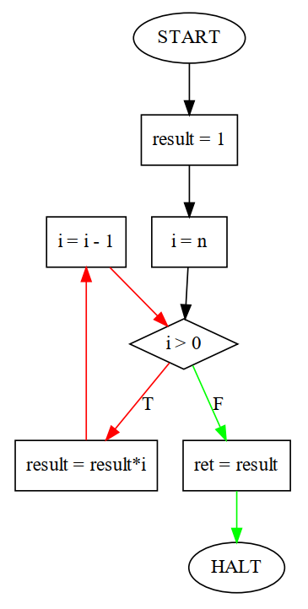
limited_ factorial_ with_while

Slide 59
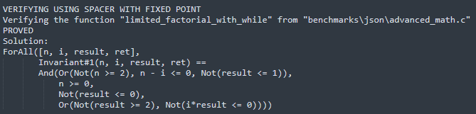
limited_factorial_with_while

Slide 60
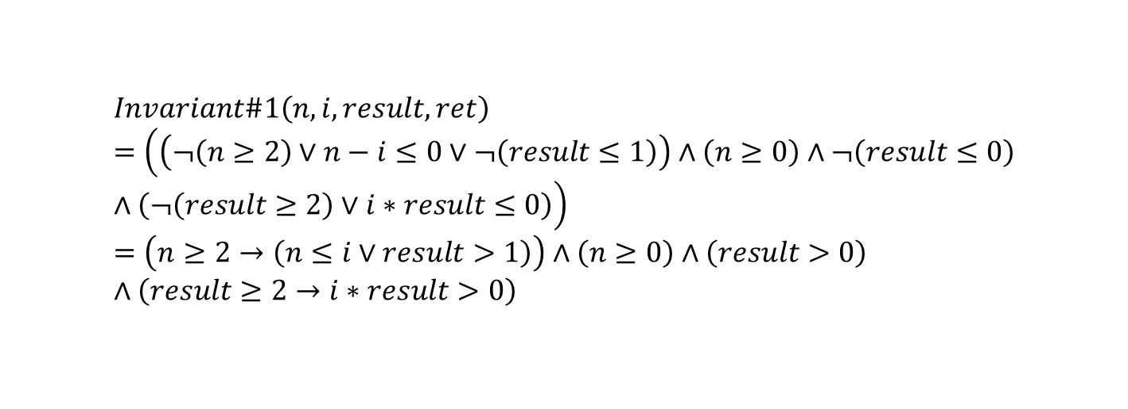
limited_factorial_with_while
$$Invariant\#1\left(n,i,result,ret\right)=\left(\left(¬\left(n≥2\right)∨n−i≤0∨¬\left(result≤1\right)\right)∧\left(n≥0\right)∧¬\left(result≤0\right)∧\left(¬\left(result≥2\right)∨i∗result≤0\right)\right)=\left(n≥2→\left(n≤i∨result>1\right)\right)∧\left(n≥0\right)∧\left(result>0\right)∧\left(result≥2→i∗result>0\right)$$

Slide 61
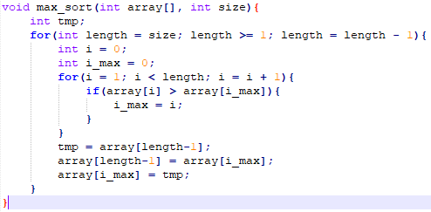
sort.c
Contains a single function: max_sort
Was proved in P mode with manually found invariants

Slide 62
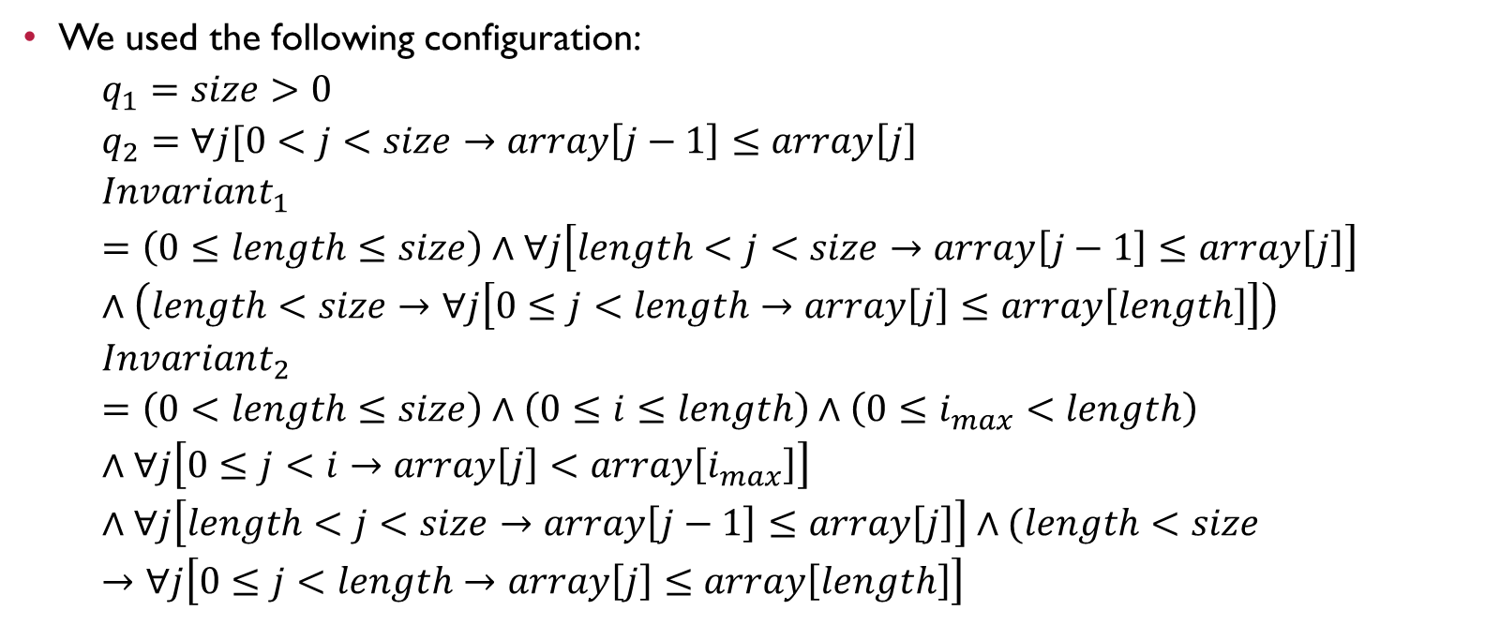
sort.c
We used the following configuration: $q_{1}=size>0$ $q_{2}=∀j[0<j<size→array\left[j−1\right]≤array\left[j\right]$ $Invariant_{1}=\left(0≤length≤size\right)∧∀j\left[length<j<size→array\left[j−1\right]≤array\left[j\right]\right]∧\left(length<size→∀j\left[0≤j<length→array\left[j\right]≤array\left[length\right]\right]\right)$ $Invariant_{2}=\left(0<length≤size\right)∧\left(0≤i≤length\right)∧\left(0≤i_{max}<length\right)∧∀j\left[0≤j<i→array\left[j\right]<array\left[i_{max}\right]\right]∧∀j\left[length<j<size→array\left[j−1\right]≤array\left[j\right]\right]∧(length<size→∀j\left[0≤j<length→array\left[j\right]≤array\left[length\right]\right]$

Slide 63
Other.c
Contains 7 functions: array_index_value_id, mc91, tricky_square, tricky_sub, two, three_same_digits, three_digit_number_duplication
array_index_value_id was proved in P mode with manually found invariants
mc91, tricky_sub, two were proved in FP mode with no given invariants
tricky_square, three_same_digits, three_digit_number_duplication were proved in FP mode with partially given invariants

Slide 64
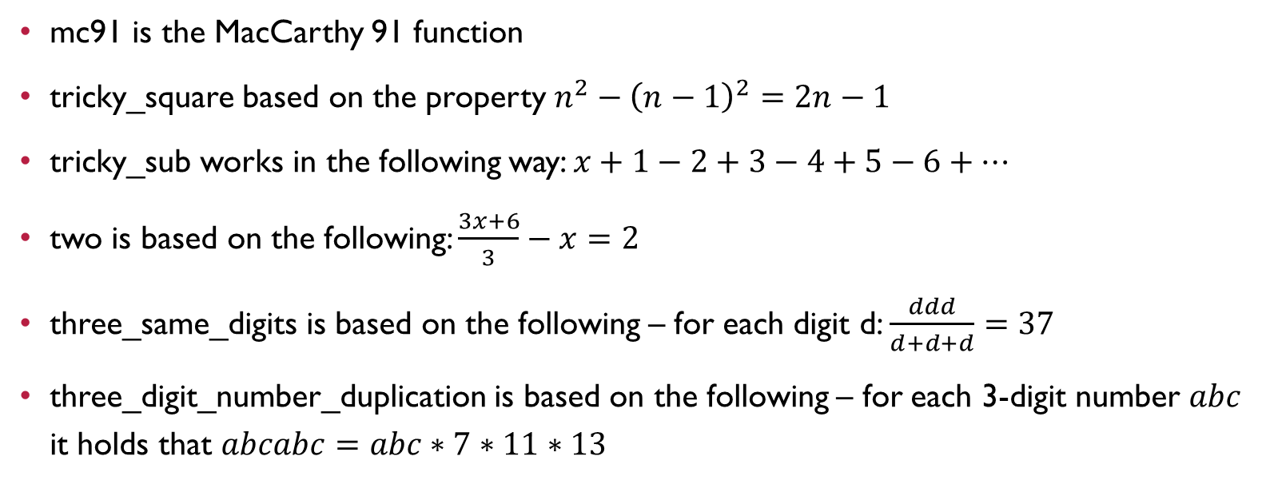
other.c
mc91 is the MacCarthy 91 function
tricky_square based on the property $n^{2}−{\left(n−1\right)}^{2}=2n−1$
tricky_sub works in the following way: $x+1−2+3−4+5−6+…$
two is based on the following: $\frac{3x+6}{3}−x=2$
three_same_digits is based on the following – for each digit d: $\frac{ddd}{d+d+d}=37$
three_digit_number_duplication is based on the following – for each 3-digit number $abc$ it holds that $abcabc=abc∗7∗11∗13$

Slide 65
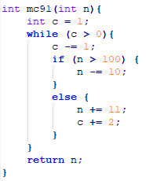
mc91

Slide 66

mc91

Slide 67
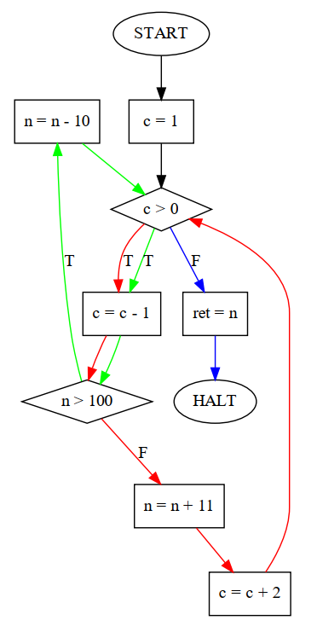
mc91

Slide 68
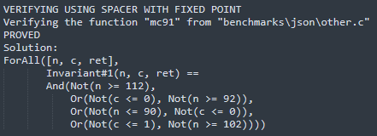
mc91

Slide 69
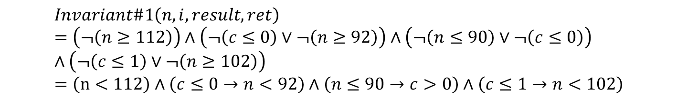
mc91
$$Invariant\#1\left(n,i,result,ret\right)=\left(¬\left(n≥112\right)\right)∧\left(¬\left(c≤0\right)∨¬\left(n≥92\right)\right)∧\left(¬\left(n≤90\right)∨¬\left(c≤0\right)\right)∧\left(¬\left(c≤1\right)∨¬\left(n≥102\right)\right)=\left(n<112\right)∧\left(c≤0→n<92\right)∧\left(n≤90→c>0\right)∧\left(c≤1→n<102\right)$$

Slide 70
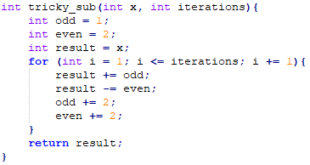
tricky_sub

Slide 71

tricky_sub

Slide 72
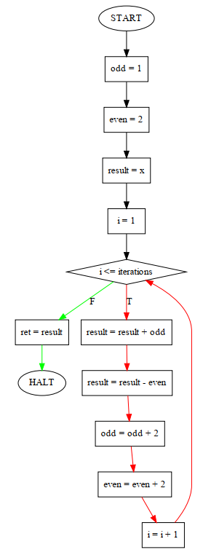
tricky_sub

Slide 73
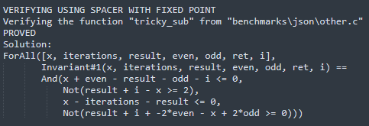
tricky_sub

Slide 74
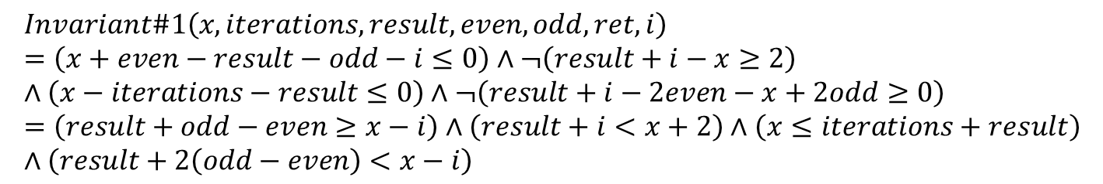
tricky_sub
$$Invariant\#1\left(x,iterations,result,even,odd,ret,i\right)=\left(x+even−result−odd−i≤0\right)∧¬\left(result+i−x≥2\right)∧\left(x−iterations−result≤0\right)∧¬\left(result+i−2even−x+2odd≥0\right)=\left(result+odd−even≥x−i\right)∧\left(result+i<x+2\right)∧\left(x≤iterations+result\right)∧\left(result+2\left(odd−even\right)<x−i\right)$$

Slide 75
wrong.c
Contains 6 functions: bad_min3, bad_add, bad_mul, bad_fibonacci_array, bad_mc91, bad_tricky_sub
bad_fibonacci_array was proved as not valid in P mode with manually found invariants
bad_min3 was proved as not valid in MHC mode (unsat), and than in P mode
bad_add, bad_mul, bad_mc91, bad_tricky_sub were proved as not valid in FP mode with no given invariants

Slide 76
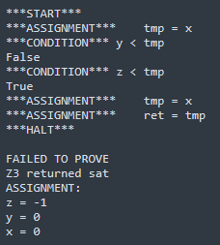
bad_min3
There is a mistake in a code in line 4 – returns x when was found that z is minimal
There were found 2 invalid paths in mode P – exactly the 2 that visits in the wrong statement

Slide 77
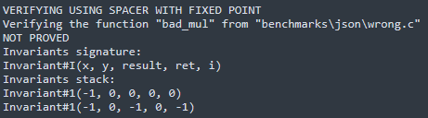

bad_mul
Here, the error is one more iteration of the loop – $i>0$ changed to $i≥0$ in the loop condition
FP verifier returned an invariants stack

Slide 78

demo

Slide 79

questions?

